Slide 1
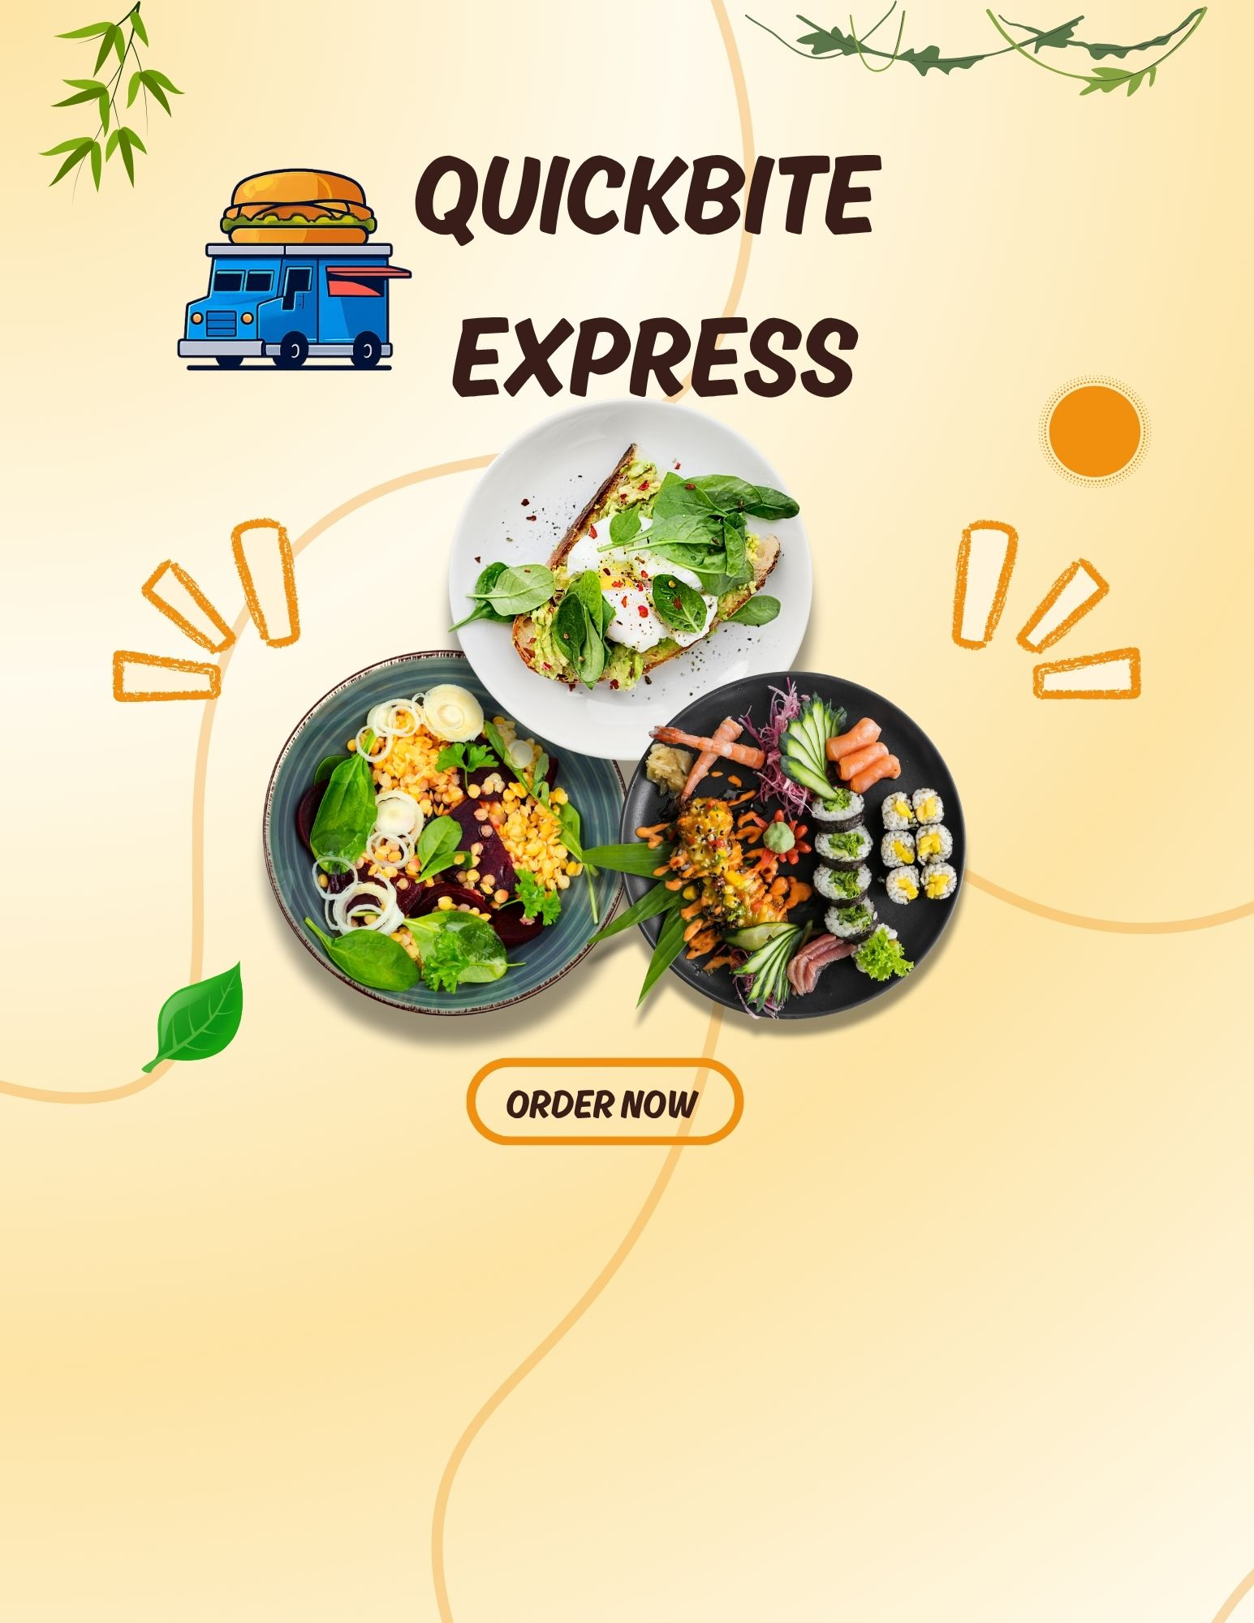

Presented by
Ankur Katiyar

Slide 2

Problem statement
QuickBite Express is a Bengaluru-based food-tech startup (founded in 2020) that connects customers with nearby restaurants and cloud kitchens.
QuickBite Express operates in 8 different cities – Ahmedabad, Bengaluru, Chennai, Delhi, Hyderabad, Kolkata, Mumbai, and Pune. The platform partners with local eateries and cloud kitchens to deliver a seamless food ordering experience.
June 2025, QuickBite faced a major crisis. A viral social media incident involving food safety viInolations at partner restaurants, combined with a week-long delivery outage during the monsoon season, triggered massive customer backlash. Competitors capitalized with aggressive campaigns, worsening the situation.

Slide 3
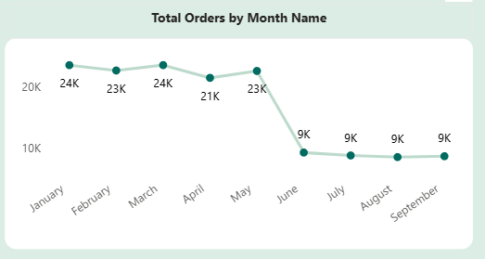

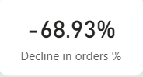
Monthly Orders Trend
Q1. Monthly Orders: Compare total orders across pre-crisis (Jan–May 2025) vs crisis (Jun–Sep 2025). How severe is the decline?
Insights:
Orders dropped by 69% from pre-crisis to crisis. Volume declined sharply after May, stabilizing at 9K monthly orders by June–September indicating a persistent slump rather than temporary volatility.
This decline impacts revenue, brand visibility, and restaurant retention simultaneously.
Recommendation :
Develop and launch a targeted recovery plan focused on re-engaging loyal customers.

Slide 4
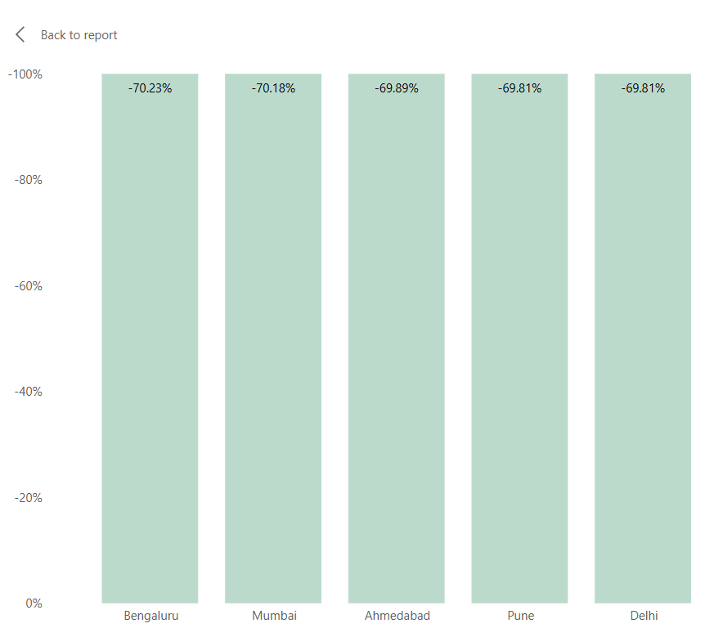
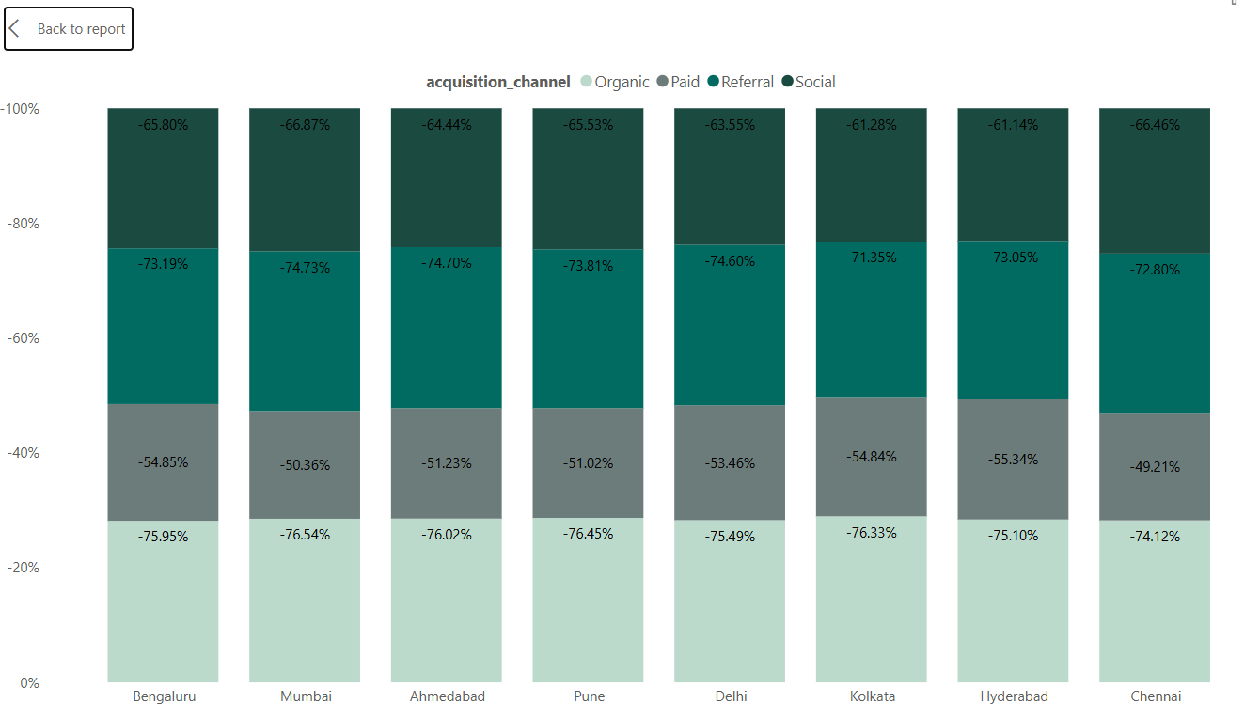
City-wise Impact
Q2. Which top 5 city groups experienced the highest percentage decline in orders during the crisis period compared to the pre-crisis period?
Insights:
Bengaluru, Mumbai, and Ahmedabad were hardest hit, showing 70% declines, while Delhi and Pune were relatively less affected.
Across acquisition channels, Mumbai’s organic orders saw the sharpest fall (76.5%), signaling weakened customer recall and engagement.
Recommendation: Implement a city-specific recovery plan focusing on high-decline regions.

Slide 5
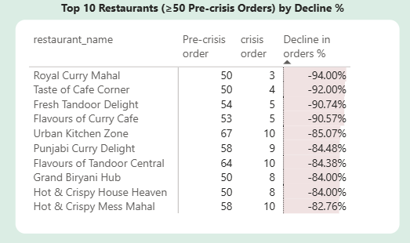
High-Volume Restaurant Decline
Q3. Among restaurants with at least 50 pre-crisis orders, which top 10 high-volume restaurants experienced the largest percentage decline in order counts during the crisis period?
Top high-volume restaurants such as Royal Curry Mahal (-94%), Taste of Cafe Corner (-92%), and Fresh Tandoor Delight (-90.7%) saw the steepest order declines. The sharp drop among established partners indicates weakened restaurant confidence and possible operational disruptions post-crisis.
Recommendation: Focus on retaining and re-engaging long-term restaurant partners through trust-building initiatives like reduced commission rates, marketing support, or loyalty incentives.

Slide 6
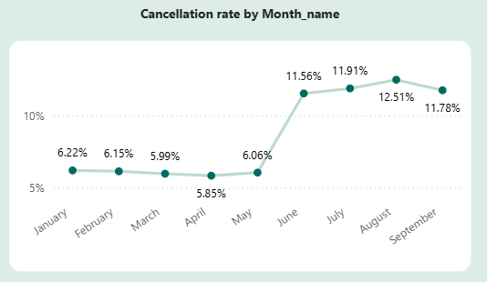


Cancellation Trends
Q4. What is the cancellation rate trend pre-crisis vs crisis, and which cities are most affected?
Pre-crisis Cancellation rate
Crisis Cancellation rate
Insights:
Cancellation rates rose sharply during the crisis, climbing from 6.1% in the pre-crisis period to 11.9%. This surge reflects growing service reliability issues—likely tied to delivery delays or poor restaurant coordination. Rising cancellations erode customer trust and weaken restaurant confidence in the platform.
Recommendations:
Strengthen real-time order tracking and restaurant communication to prevent last-minute cancellations.
Integrate customer feedback loops to address recurring complaints and improve satisfaction.

Slide 7
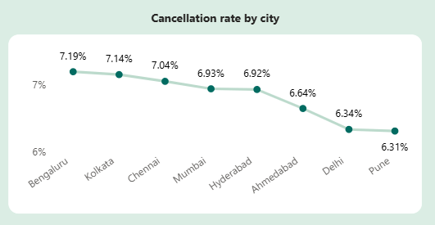
Insights:
Bengaluru has highest cancellation rate followed by Kolkata, Chennai and Mumbai during the Crisis period.

Slide 8
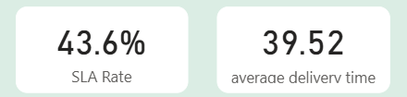
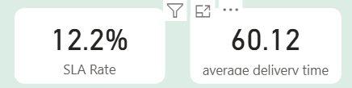
Delivery SLA
Q5. Measure average delivery time across phases. Did SLA compliance worsen significantly in the crisis period?
Pre-crisis
Crisis
Insights:
Average delivery time has increased from 39.5 mins to 60 min.
SLA rate has worsened from 43.6 % to 12.2 % indicating that most deliveries failed to meet promised timelines.
Recommendations:
Reassess delivery partner allocation and route optimization, especially in high-traffic or weather-affected zones.
Introduce SLA monitoring to flag delays in real time.
Pilot priority delivery for high-value customers to rebuild reliability perception.

Slide 9
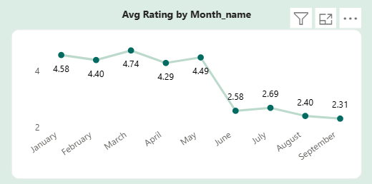
Customer Ratings
Q6. Track average customer rating month-by-month. Which months saw the sharpest drop?
Insights:
Ratings dropped from 4.74 in March to 2.58 by June, before stabilizing slightly in September reflecting a severe loss of confidence following the food safety incident and delivery disruptions.
Recommendations:
Launch a customer reassurance campaign highlighting improved safety protocols and delivery reliability.

Slide 10
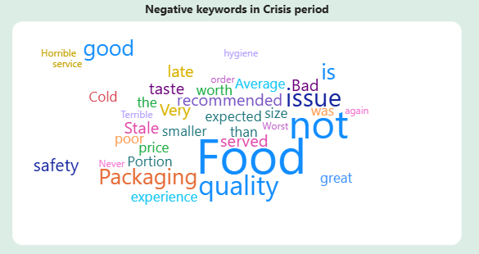
Sentiment Analysis
Q7. During the crisis period, identify the most frequently occurring negative keywords in customer review texts.
Insights:
Most frequent negative Keywords include- “Food Quality”,” Not”,” Good”,” safety”,” issues. This clearly indicates that trust in food safety and consistency became the dominant concern among customers.
Recommendations:
Roll out visible food safety certifications for partner restaurants on the app.
Highlight verified hygiene tags and promote partners who pass new safety audits.

Slide 11
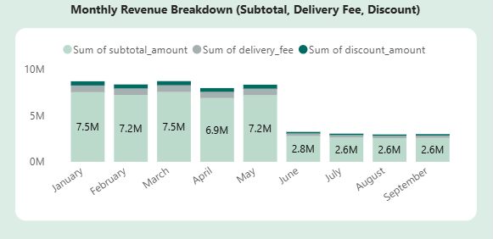

Revenue Impact
Q8. Estimate revenue loss from pre-crisis vs crisis (based on subtotal, discount, and delivery fee).
Insights:
Revenue dropped from ₹37.6M pre-crisis to ₹11M during crisis (70.9 % decline).
Discounts also reduced proportionally, showing lower marketing spend.
Recommendations:
Introduce targeted discount campaigns for lapsed high-value customers to stimulate order recovery.

Slide 12
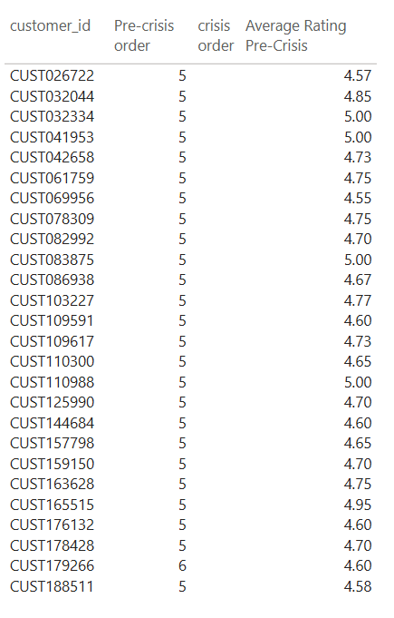


Loyalty Impact
Q9. Among customers who placed five or more orders before the crisis, determine how many stopped ordering during the crisis, and out of those, how many had an average rating above 4.5?
Out of 58 loyal customers (5+ orders) pre-crisis, 49 stopped ordering during crisis , and 30 of them had ratings above 4.5.

Slide 13
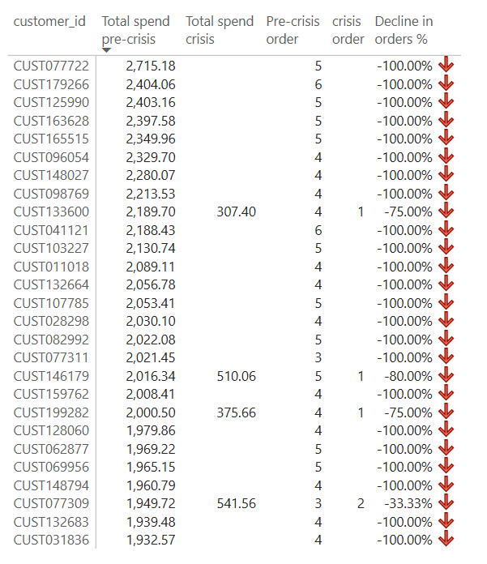
Customer Lifetime Decline
Q10. Which high-value customers (top 5% by total spend before the crisis) showed the largest drop in order frequency and ratings during the crisis?

Slide 14
Crisis Snapshot: QuickBite vs Competitors (Q2 FY25)
QuickBite Performance Decline
69% drop in orders and 71% revenue loss
95% churn among top spenders
SLA rate declined to 12.2 %
Acquisition volume collapsed by 80%; CAC tripled
Tier-1 cities saw the steepest acquisition decline
Competitor Highlights
Swiggy Q2 FY26 Forecast
Revenue Growth: Expected 49% YoY increase to ₹5,348.2 crore
Food Delivery Revenue: 20% YoY growth
Instamart Revenue: Predicted 102% surge
Growth Drivers: Bolt delivery model, user base expansion
Swiggy: 5.6% QoQ growth in food delivery; 24% in quick commerce via SwiggyOne and scale
Zomato: Gained edge through gamified loyalty, hygiene storytelling, and hyperlocal influencer campaigns.
Acquisition Collapse vs CAC Surge
Insights:
New customer acquisition fell from 22.5K to 5K/month (80% drop)
CAC more than tripled, with no external cost drivers (e.g., ad pricing or seasonality)
Conversion inefficiency driven by SLA breaches and negative sentiment
Trust erosion severely impacted funnel performance

Slide 15
Customer Risk Classification
Customer Risk Segments:
High Risk: Loyal customers (≥5 pre-crisis orders, avg rating ≥4.5) who made no orders during the crisis. Immediate focus group for recovery campaigns.
Medium Risk: Customers with moderate engagement (2–4 pre-crisis orders) Require reactivation offers.
Low Risk: Customers who ordered less frequently during pre-crisis but remained somewhat active.
Retained Customers: Those who continued ordering across both phases.

Slide 16
Customer Recovery Strategy
Key Recommendations
Re-engage High-Risk Loyal Customers
Offer personalized cashback and targeted “We Miss You” campaigns through email and in-app messages. Prioritize rebuilding trust by highlighting improved food safety and service reliability.
2. Revive Medium-Risk Customers
Deploy app notifications, loyalty points, and small-value vouchers to encourage reactivation. Focus on reminding them of platform benefits and improved reliability post-crisis.
3. Nurture Low-Risk Customers Use light-touch communication such as feedback surveys and appreciation emails to maintain engagement without excessive incentives.
4. Reward and Retain Active Customers Introduce tiered loyalty rewards and referral incentives to strengthen advocacy among retained users and drive organic acquisition.

Slide 17
Strategic Focus
Use Risk Tiering to Drive Retention
High Risk: Immediate personalized outreach and trust-rebuilding efforts.
Retained: Leverage for positive reviews, referrals, and upselling premium offers.
Cuisine-Specific Campaigns Sales of Biryani and North Indian cuisines dropped the most during the crisis. Launch cuisine-based offers and highlight verified-safe restaurants to regain interest in these popular categories.

Slide 18
Churn Impact by Restaurant Value Segment
High Value (Churned) - Restaurants with >50 pre-crisis orders
Middle Value (Churned) - Restaurants with ≥ 30 pre-crisis orders
Lower Value (Churned)- Restaurants with < 30 pre-crisis orders
Is_Active- Restaurant which are still active.

Slide 19
Key Recommendations for Restaurant Retention
1. Prioritize High-Risk Partners Concentrate retention initiatives on restaurants with strong pre-crisis performance but declining recent engagement. Provide personalized incentives, operational assistance, and targeted reactivation programs to rebuild confidence and sustain supply diversity.
2. Implement Tiered Retention Campaigns
High-Value Partners: Offer loyalty bonuses, priority visibility on the platform, and temporary commission relief to reinforce partnership stability.
Medium-Risk Partners: Deliver operational coaching focused on SLA adherence, order preparation efficiency, and customer service consistency.
Low-Risk Partners: Maintain steady engagement through automated performance dashboards and periodic check-ins.
3. Track Operational Health Metrics Leverage SLA rate and average preparation time as early indicators of potential disengagement. Set up automated alerts to flag restaurants with rising prep times or deteriorating SLA performance, enabling timely intervention by partner management teams.

Slide 20
Thank You

